Slide 1


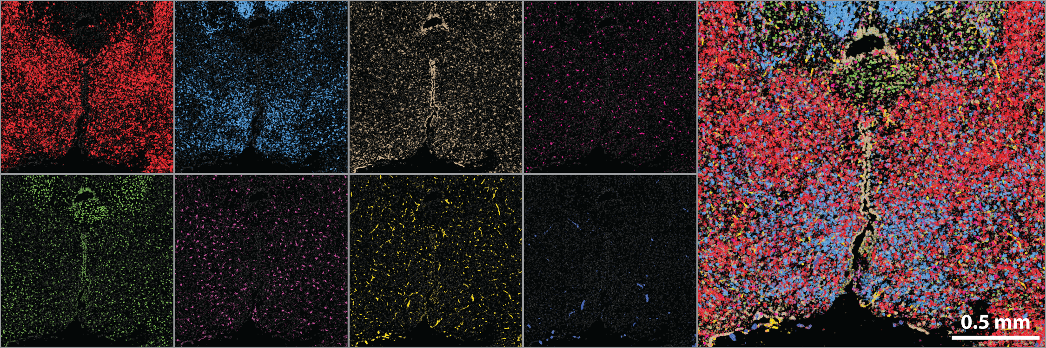
Equipping spatial transcriptomics with CRISPR
Ruwaida Raneem Rajna
Evan Yang
Moffitt Lab
Boston Children’s Hospital
Harvard Medical School
Notes:
the name of my project is Equipping spatial transcriptomics with CRISPR. This summer, I worked on a project that aims to extend spatial transcriptomics by creating in situ gene perturbations within single cells. By creating these perturbations in tissues, we wanted to craft a system that will allow us to track gene expressions of complementary ligands and receptors and plot the organization of different cell types that gives a structure to the tissue. My summer consisted of cloning a lentiviral plasmid with single guide RNA sequences that will track these relationships between these complementary ligands and receptors and give us an image of how the tissue structure is intricately formed.

Slide 2
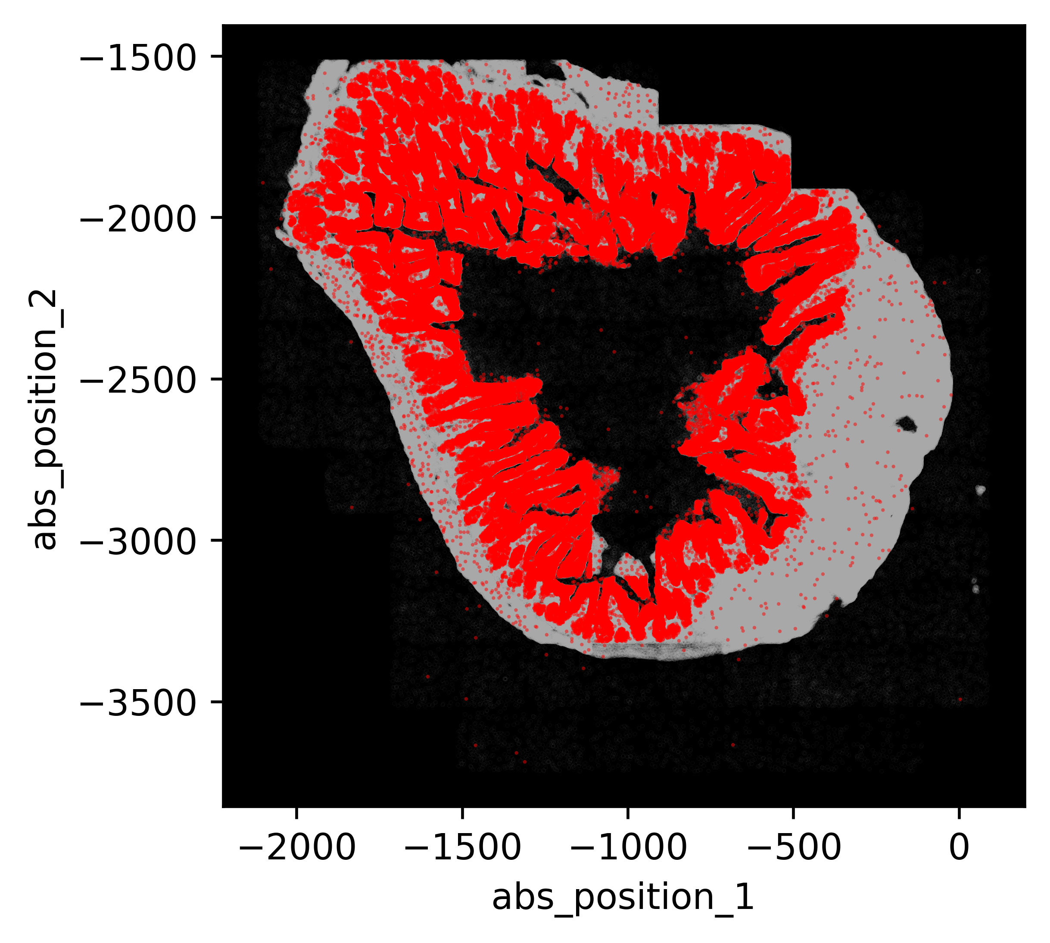
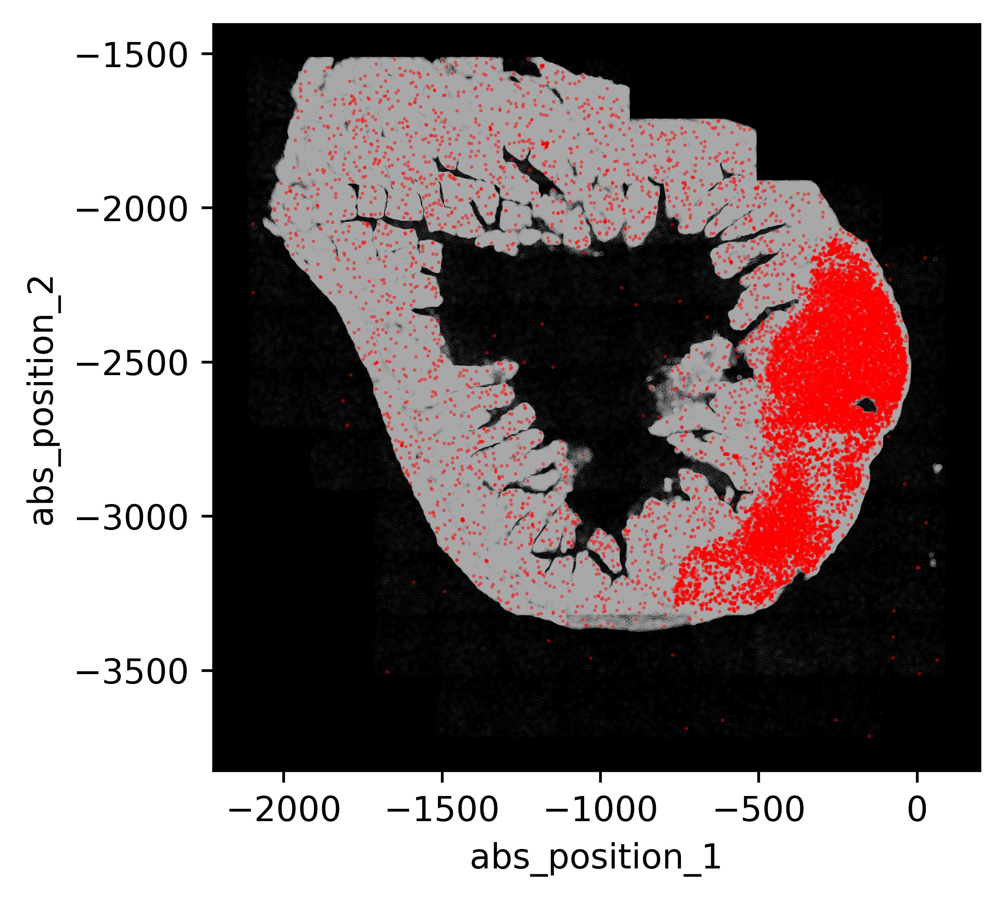
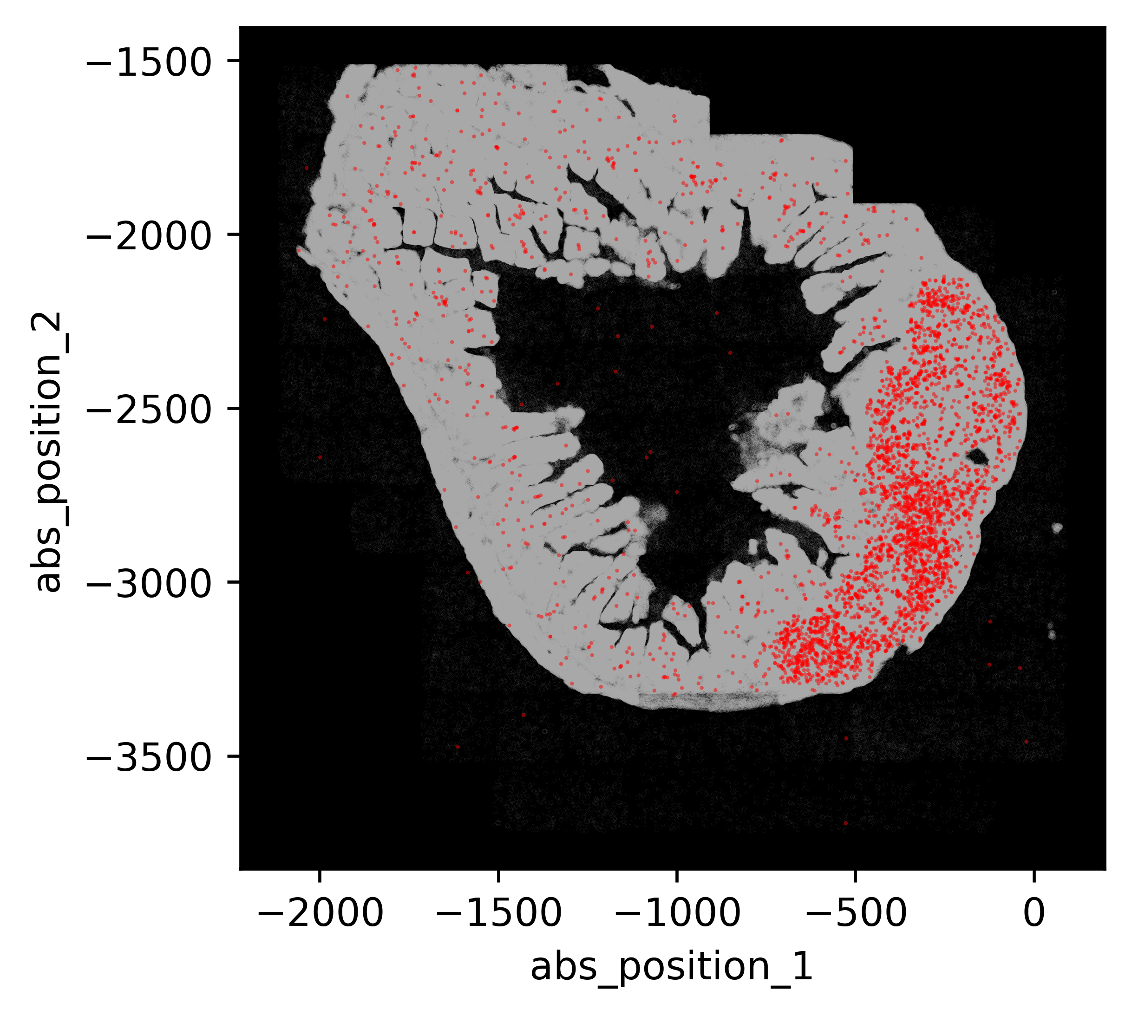
What is spatial transcriptomics?
Study of multiple RNA expression within intact and complex tissue systems to study gene expression and cellular interactions
Vil1
Epithelial cells
Cd19
B cells
Cd4
T cells
Notes:
So, we might want to ask, what is spatial transcriptomics? It is studying the expression of RNA molecules within intact complex tissue structures that tells us about the gene expression, cell-cell interaction, cell neighborhood organizations and plenty more.
If you look at the first image, this is a spatial transcriptomic image of the small intestine in mice which was taken through MERFISH. Here, each red dot is mapping a particular gene within a distinct cellular region. First image is expressing the Vil1 gene inside the epithelial region of the small intestine. The second image expresses gene CD19 which is expressed within the B cell and the gene CD4 is being expressed in T cells. All these images are taken at a single point in time. So, these images are not only telling us how many RNA expressions are taking place, but also giving us a visual image of the different cellular compartments and perhaps hinting at the relationships between those compartments.

Slide 3
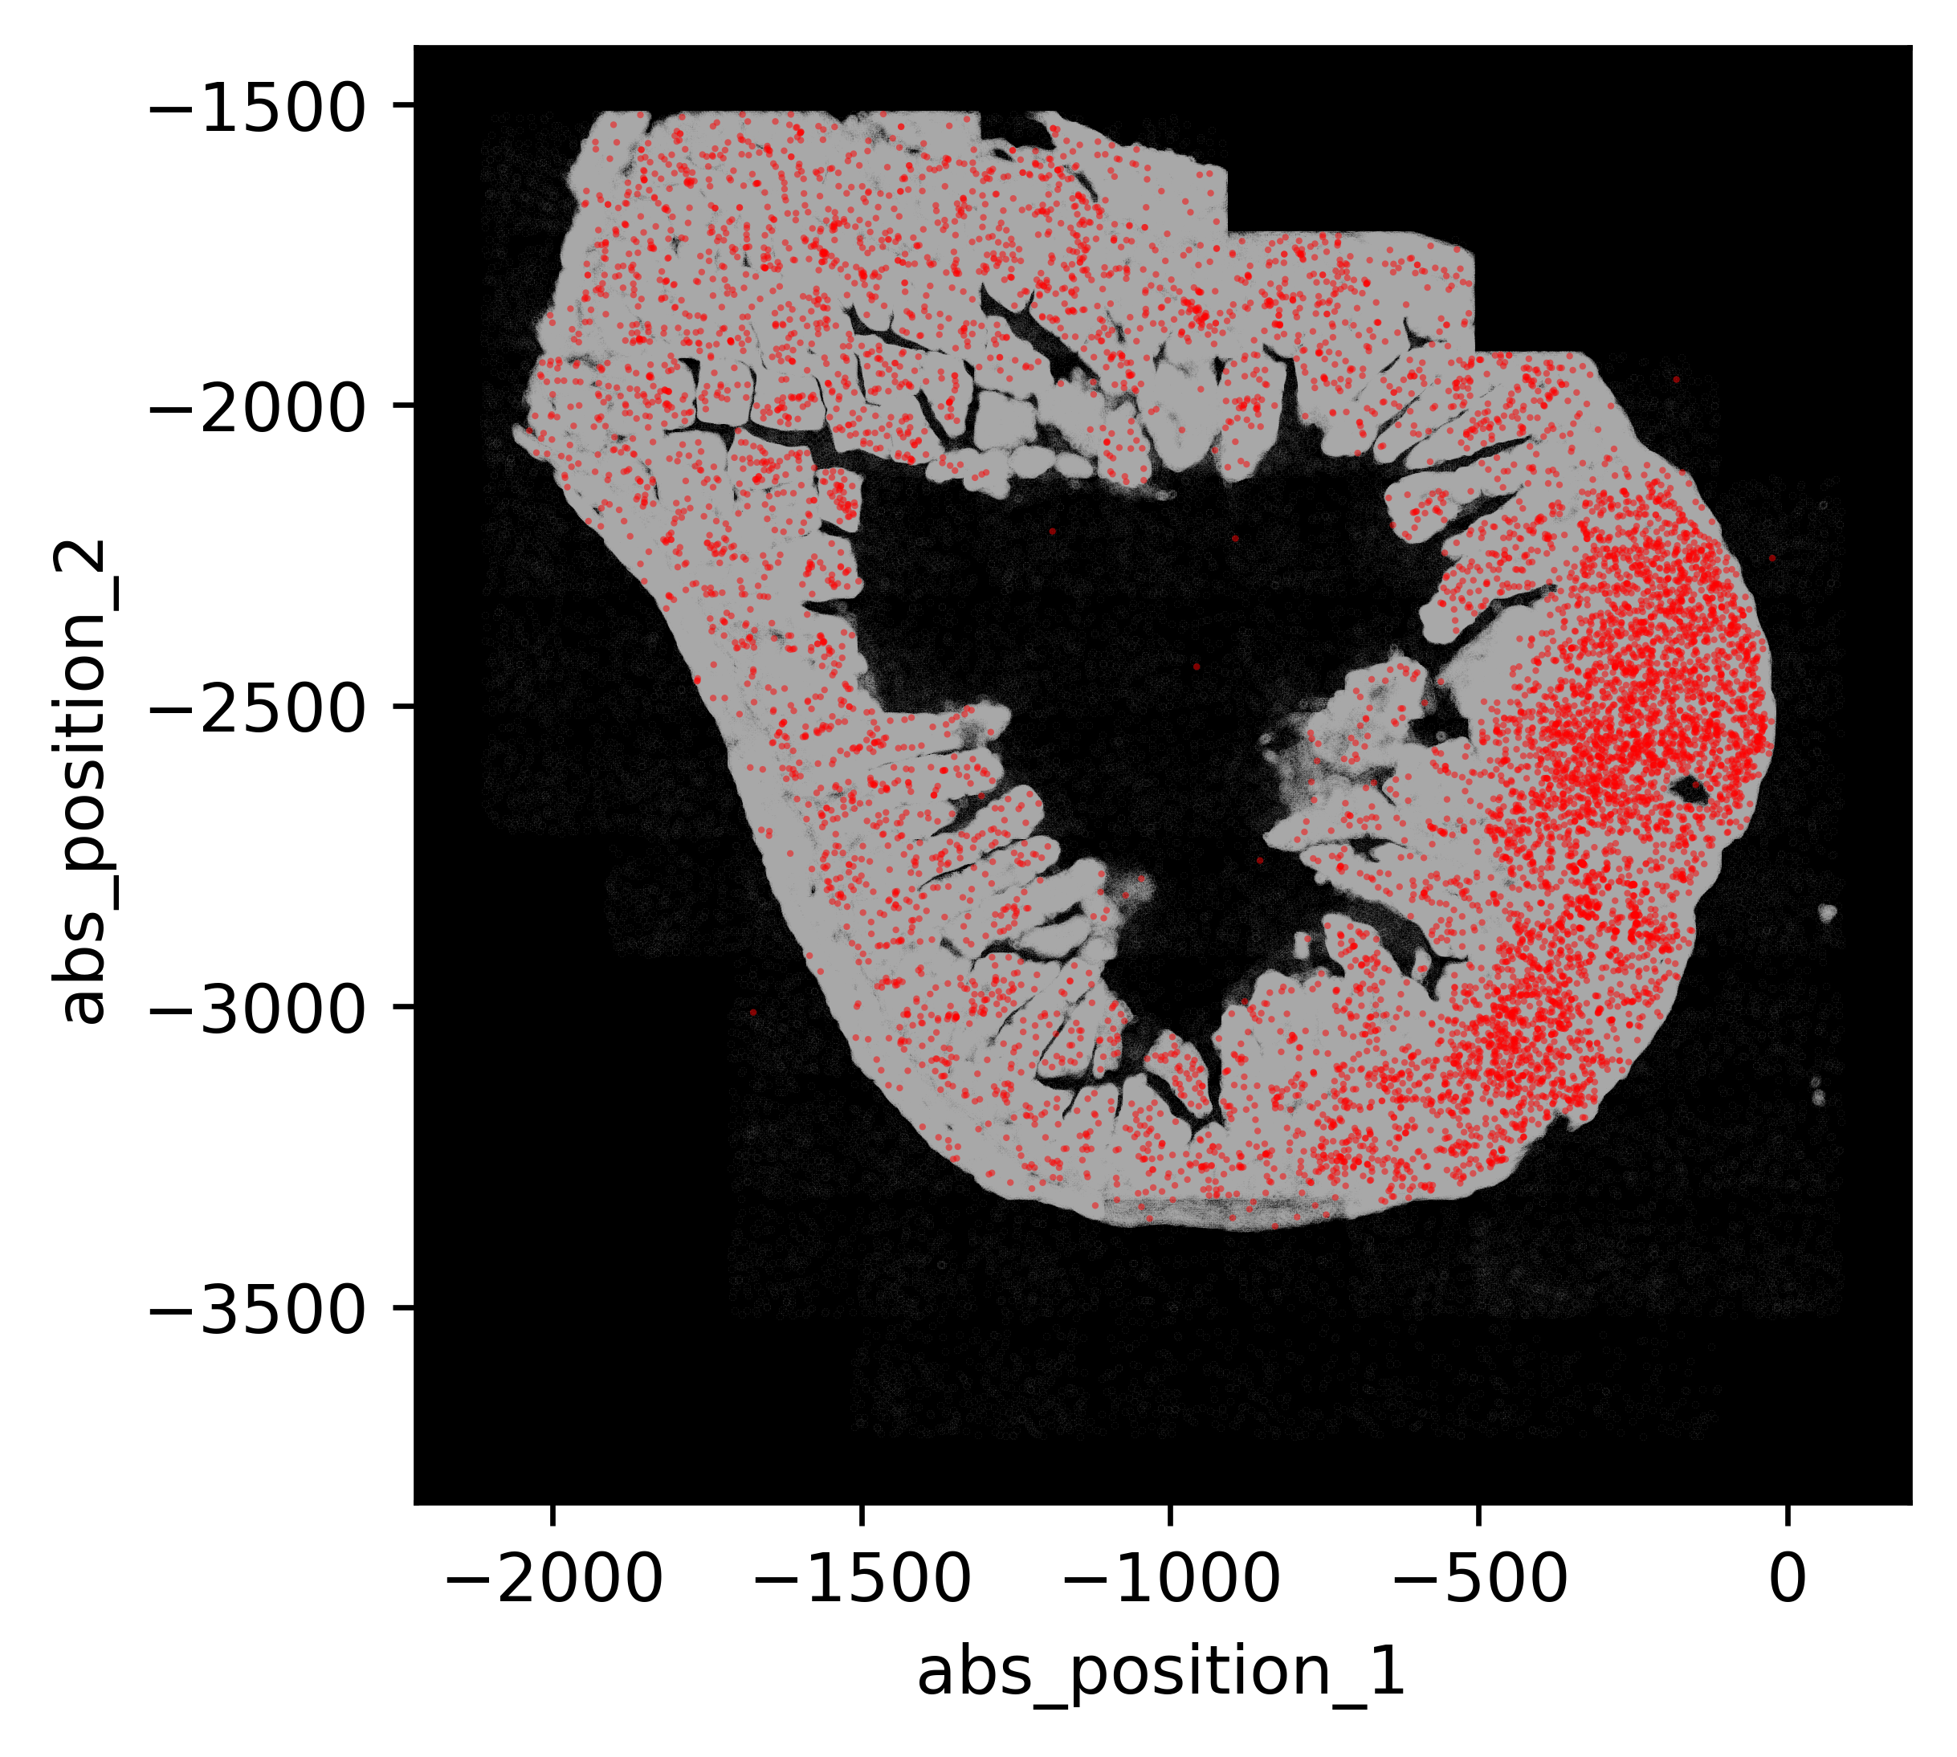
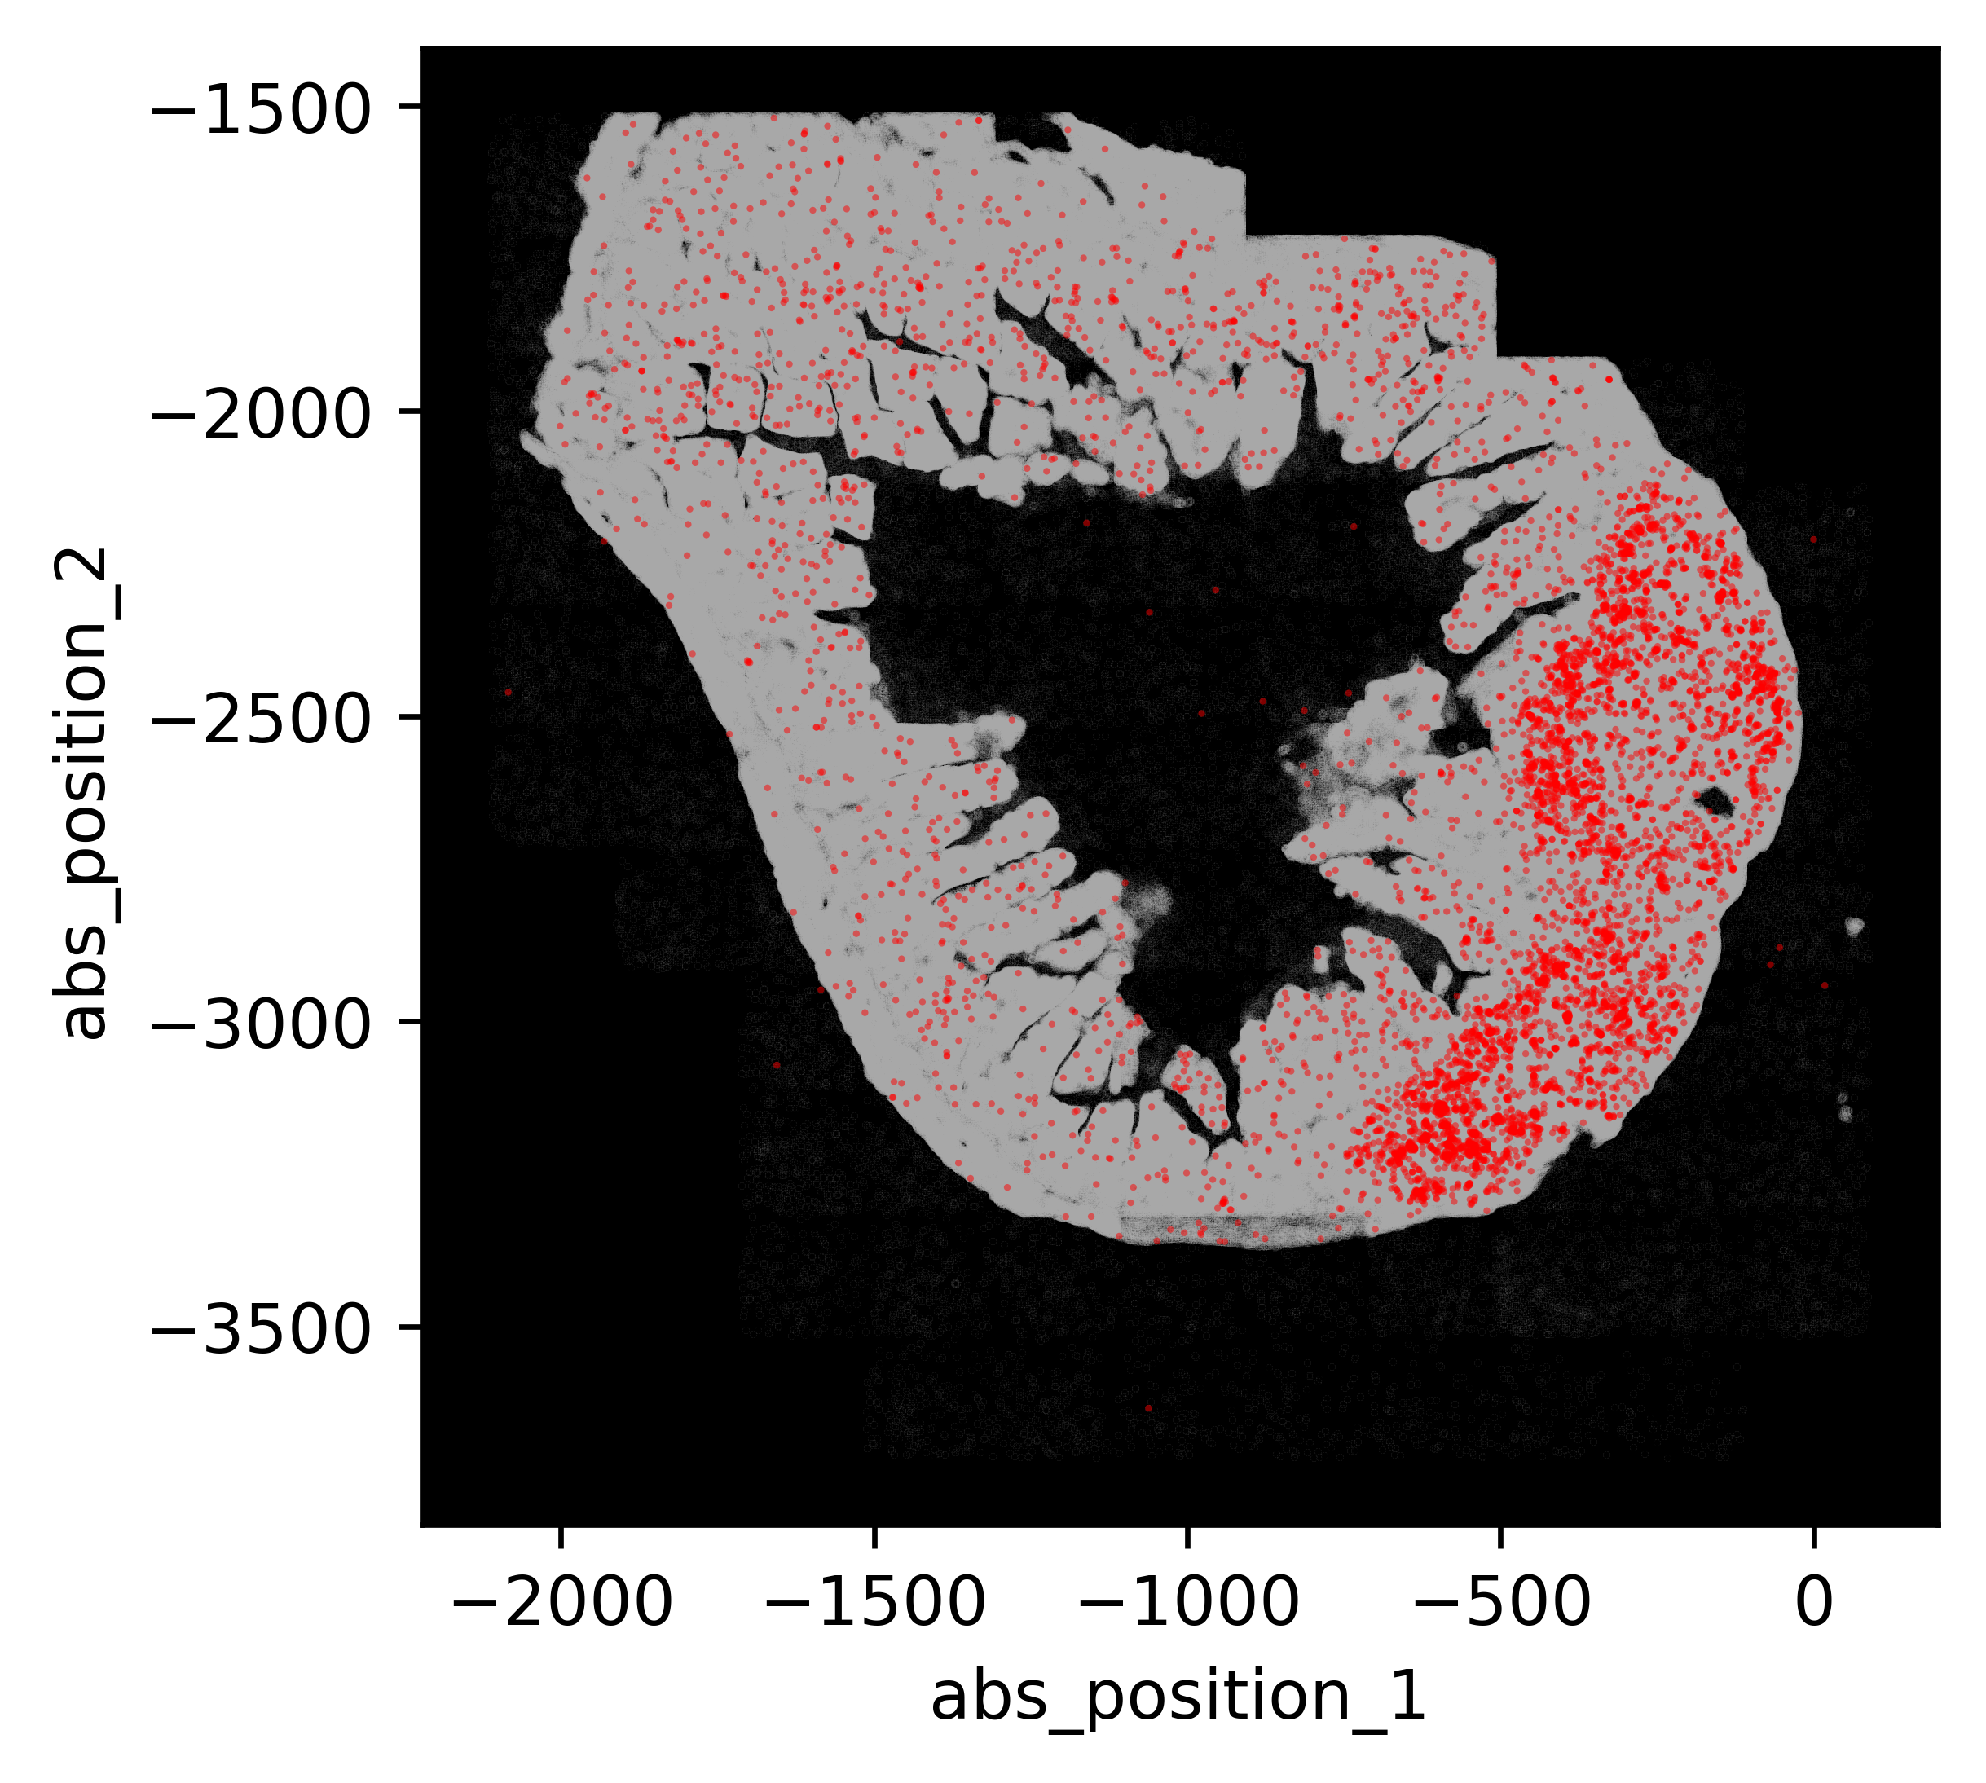
What is spatial transcriptomics missing?
Spatial transcriptomics does not allow us to create in vivo perturbations
Icosl
B cells
Icos
T cells
Notes:
Let’s look at these two images for example, these two images are expressing the complementary receptor and ligand Icos in T cells and Icosl in B cells. As you can see here, they both are in the same region kind of adhering to each other. We can hypothesize from this interaction that both these genes are communicating or interacting to accomplish a certain function. But this is still a hypothesis, how do we test that? Well, something we could do is knock out one out of the pair and analyze their cellular positioning afterwards. While spatial transcriptomics allow us to create those knockouts or gene perturbations, they don’t allow us to make multiple perturbations in one mouse. So, if we want to create 12 deletions, we would require 12 separate mice to create one deletion in each which is time consuming and also less efficient

Slide 4
Why is CRISPR important here?
CRISPR induces multiple genetic perturbations in vivo by leveraging single guide RNAs (sgRNAs) in one mice
One unique gene deletion one unique sgRNA
What is CRISPR-MERFISH?
CRISPR-MERFISH will allow us to create perturbations and track sgRNAs in intact tissues
CRISPR – Clustered Regularly Interspaced Short Palindromic Repeats
MERFISH – Multiplexed Error Robust Fluorescent in situ Hybridization
Notes:
This is where CRISPR comes into play. CRISPR is a technology that will allow us to create multiple gene perturbations or deletions in one mouse. We can leverage these perturbations with specific single guide RNA (sgRNA) sequences so that one unique deletion can specify for one unique sgRNA. After that we can track these sgRNAs using a spatial transcriptomic technology known as MERFISH. MERFISH is an imaging technology that has created all these images that you have seen so far. So, WE are proposing CRISPR-MERFISH that we think will create multiple perturbations in vivo AND help us track these sgRNA to study the relationships of these complementary ligands and receptors.

Slide 5
How do we design CRISPR-MERFISH?
Reporter or Untranslated Random Sequence (URS) detection infers sgRNA identity
sgRNA 1
Reporter 1 / URS 1
Vex Fluor
sgRNA 2
Reporter 2 / URS 2
Vex Fluor
sgRNA N
Reporter N / URS 3
Vex Fluor
Probe attachment with Reporter sequence
probes
Reporter N
Reporter
Notes:
So, we want to track sgRNAs in vivo. How do we design for this? We are creating a reporter system where one unique reporter or we call it untranslated random sequence (URS) will bind to each sgRNA sequence inside a lentiviral plasmid. This reporter will then bind to multiple RNA fluorescent probes and get detected through MERFISH.

Slide 6
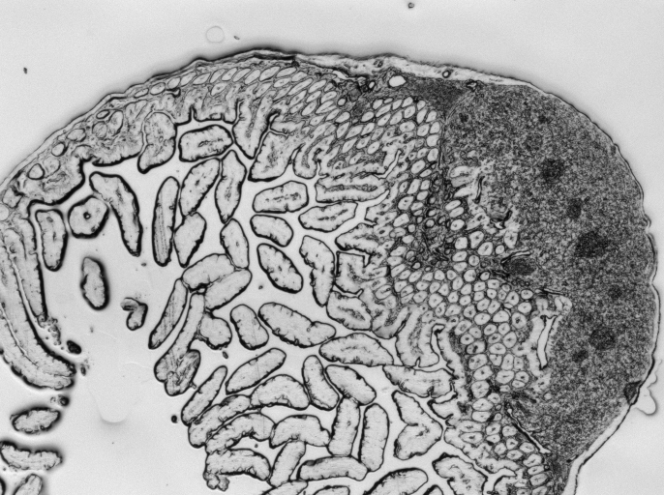
What sgRNAs are we going to use?
Peyer’s Patch
Target Gene | Gene Function | # sgRNA’s
Ccr6 | SED localization | 4
Cxcr5 | LZ localization | 4
Cxcr4 | DZ localization | 4
Ebi2 | Outer follicle localization | 4
S1pr2 | GC retention | 4
Ccr9 | Ileum honing | 4
vil1 | N/A in immune cells | 3
Non-target | N/A | 3
Notes:
To validate this technology, we want to test it inside the Peyer’s Patches in mice which are lymphatic tissues inside the small intestine. Peyer’s patch is heavily involved in B cell maturation. The genes involved in B cell maturation are spatially regulated and segregated and as you can see in this image, each segment does a different job of B cell maturation. So, we wanted to target 30 genes that are involved in B cell affinity maturation and use CRISPR-MERFISH to determine the relationships between the different compartments and their cell types.

Slide 7
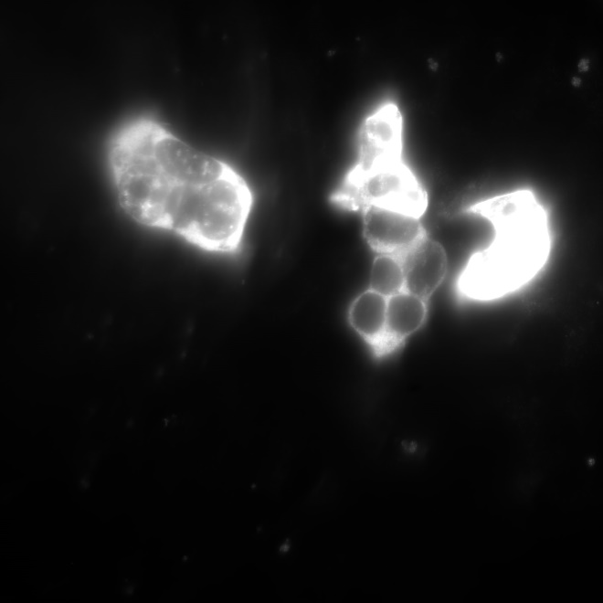
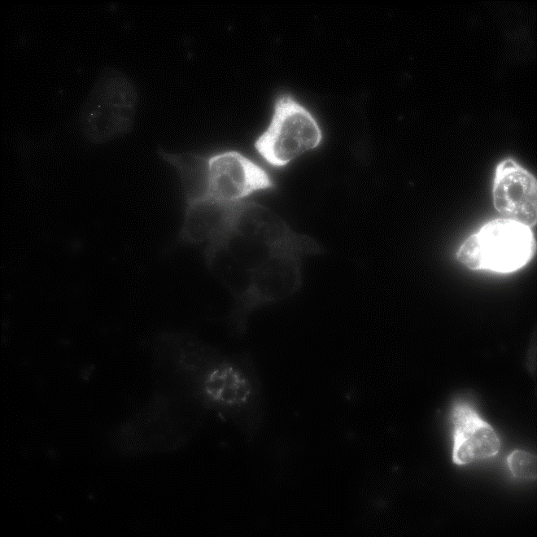
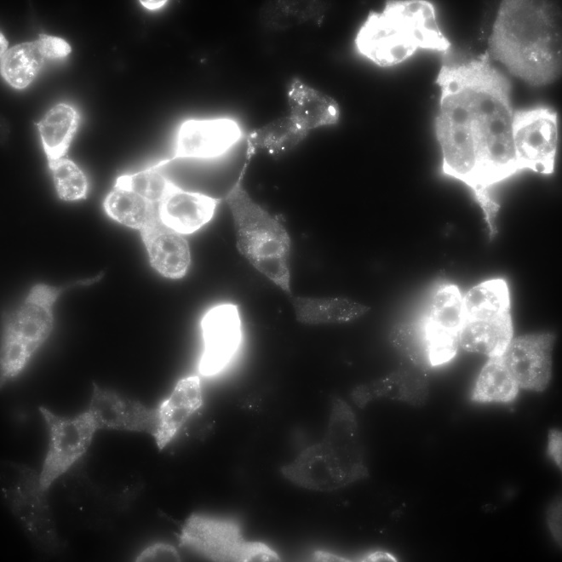
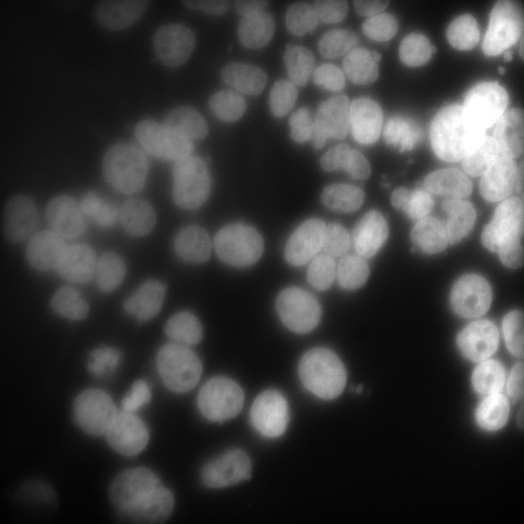
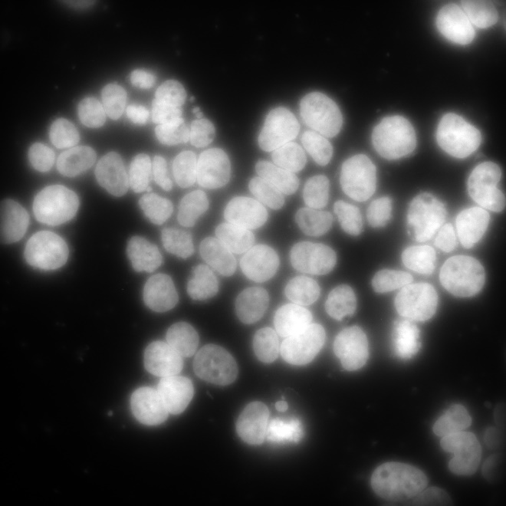
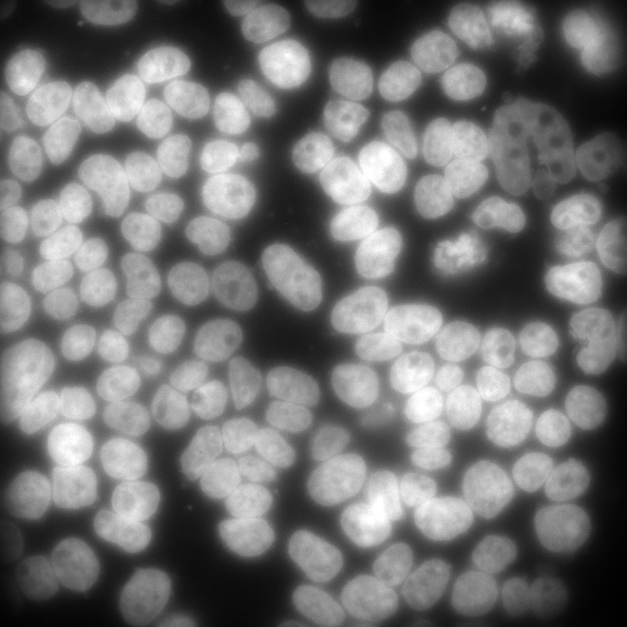
What reporters are we going to use?
URS1
URS2
URS3
Reporters OR URS:
500bp long
No ‘ATG’ sequence
45-55% GC
FISH
DAPI
Notes:
Then we wanted to go ahead and test the reporters by itself before we attached to their sgRNA pairs. This experiment was done by my mentor where he designed a group of reporters that are going to be untranslated, so no ATG sequences are going to be 500 base pairs long and will have a GC content of 45-55%. The bottom row is the image of these reporters which was stained in DAPI stain which as you can see is not very clear, but with the FISH stain they are very distinct and clear. This confirmed us that URS can be detected by the RNA florescent probes through MERFISH

Slide 8
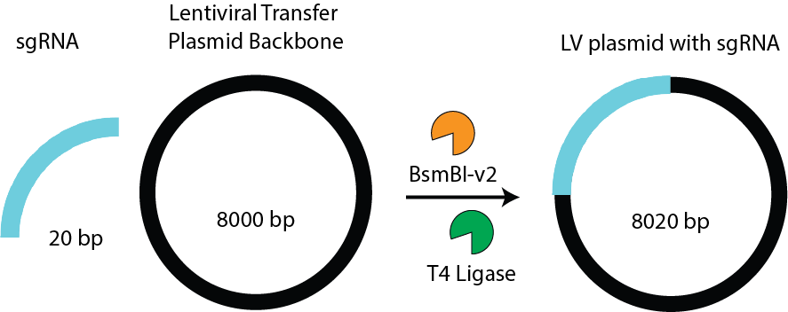
Insert 30 unique sgRNAs
Notes:
This is the design for the insertion of the 30 sgRNAs that we are going to clone inside the lentiviral plasmid. The BsmBI enzyme is going to cut the plasmid and T4 ligase is going to attach the sgRNA into the plasmid. This is known as the Golden gate assembly experiment.

Slide 9
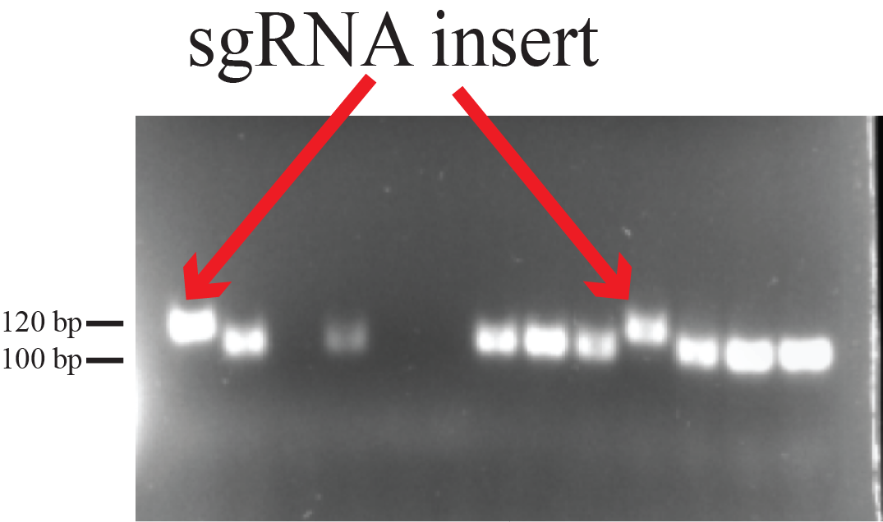
Result: Colony PCR gels indicate sgRNA insertion
Notes:
After each experiment, we did a colony PCR gel run where we picked colonies to see if they had an insert of 20 base pairs. And as you can see this is just one example of the insertion taking place. This experiment had to be repeated many times. So far, we were able to collect 25 plasmids with insertions, and the remaining 5 gRNAs were sent for redesigning.

Slide 10
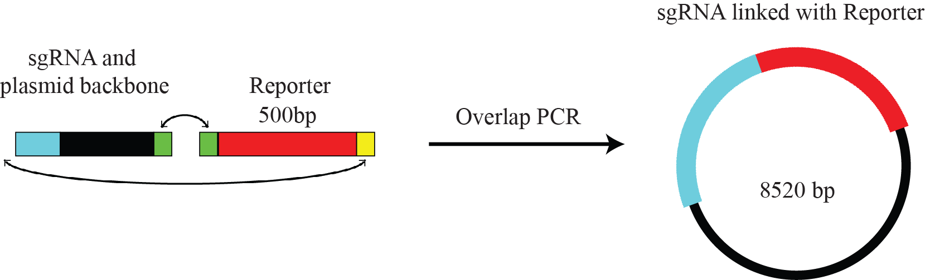
Insert 30 unique reporters
Notes:
This is the design for the insertion of the reporters downstream to their unique gRNAs. So, (show them) this is the plasmid construct that we want to achieve. We are trying to use Gibson Assembly to bring all these pieces together, which is the backbone and the sgRNA and the URS fragment. They have these overlapping overhangs that are going to fall in place and give us this construct. But first I had to amplify and purify the URS fragments from its original plasmid construct.

Slide 11
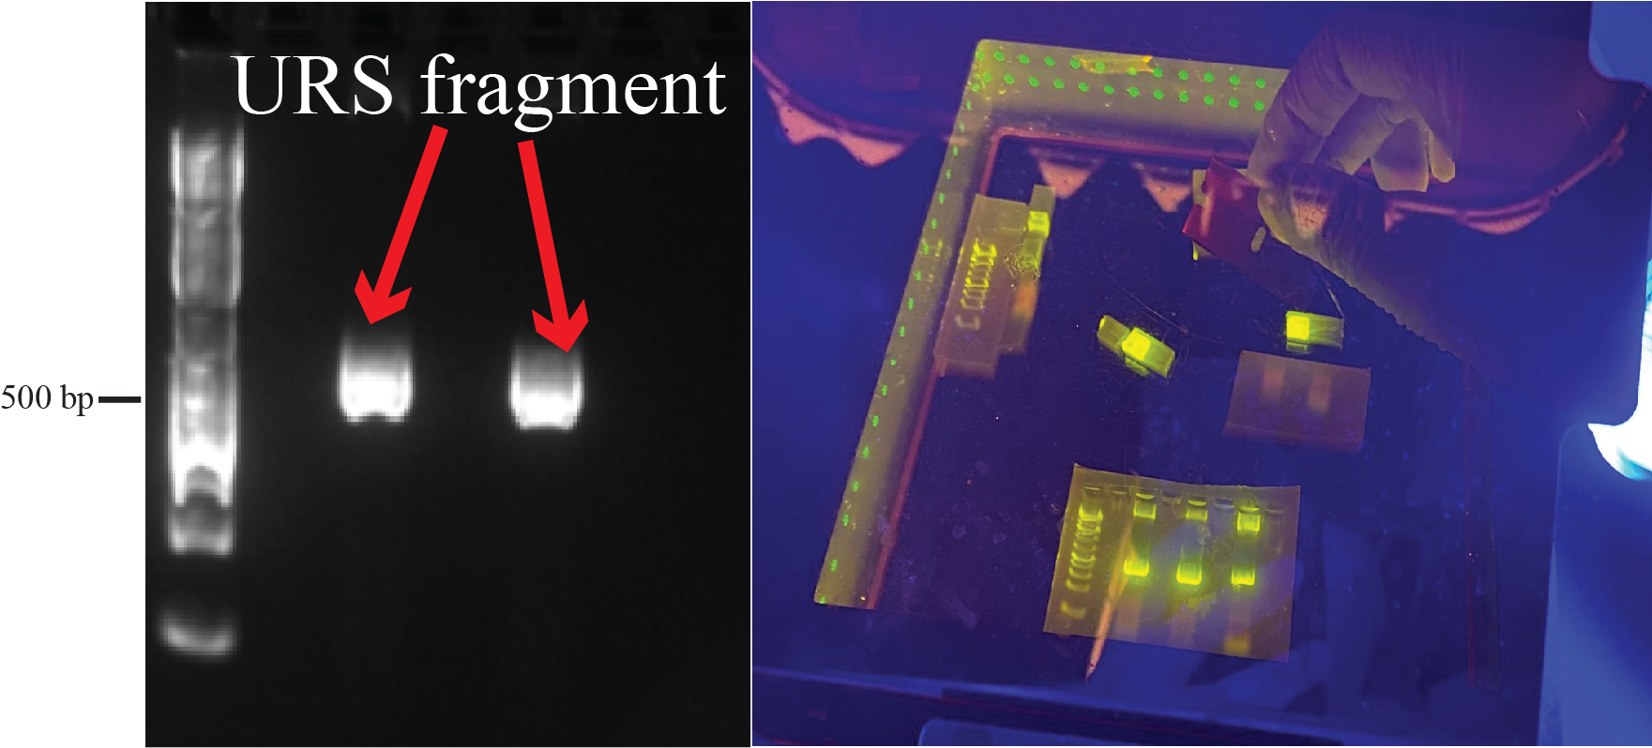
Result: PCR amplification of reporter (URS) fragments for assembly
Agarose Gel excision: To extract reporter
Notes:
So, this is me running a gel after I amplified the URS fragments from its original backbone. And then in order to collect the URS fragment, here I am doing an agarose gel excision where I cut the URS fragments out and purify it from the gel.

Slide 12

Future Directions
Gibson assembly
Lentiviral delivery in mammalian cells
Notes:
So now that we have our sgRNA insertions and URS fragments, our next steps would be to complete the Gibson assembly to achieve the final construct
and after that want to transform the plasmids into lentiviruses which will infect the mammalian cells to deliver the plasmids.
We think CRISPR-MERFISH is also a revolutionary research because it can answer a variety of biological questions pertaining to gene expression and spatial transcriptomics in the future.

Slide 13
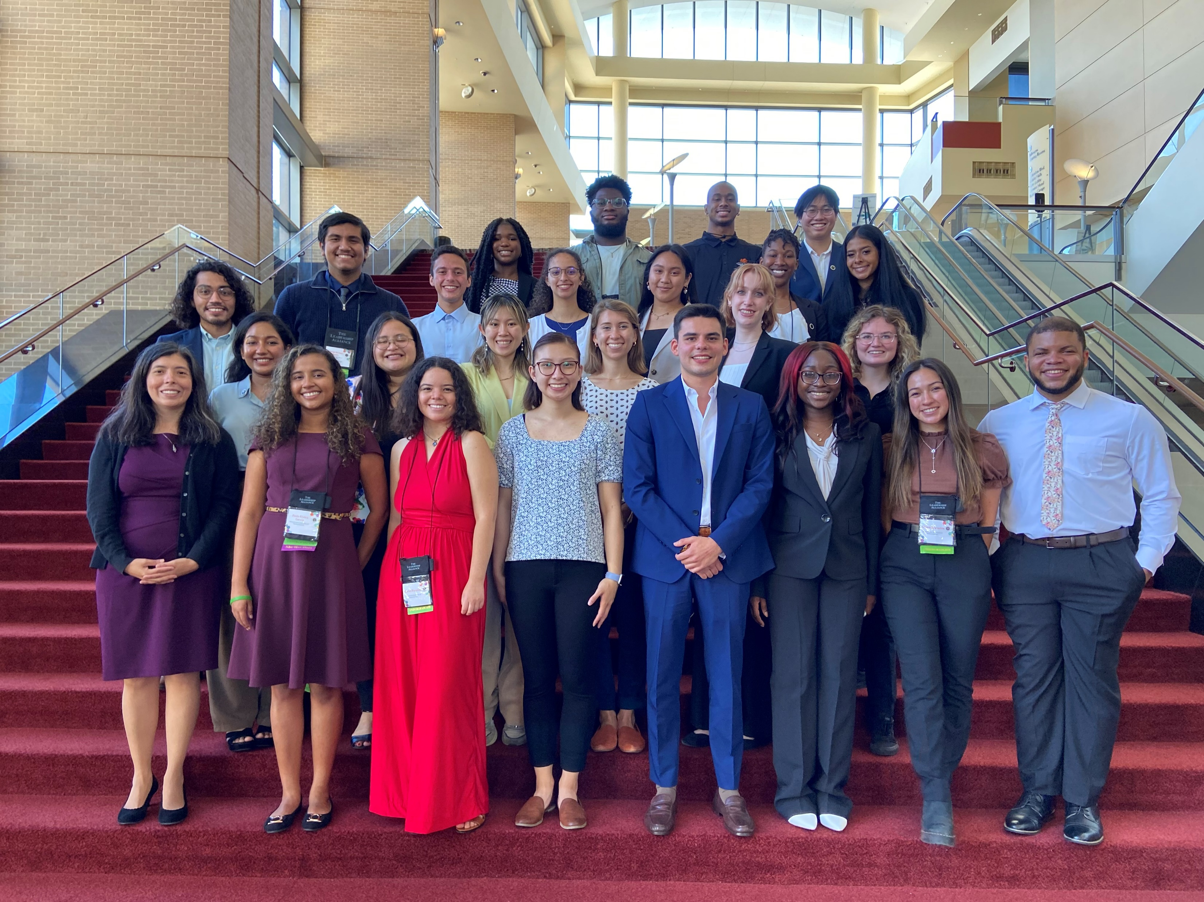

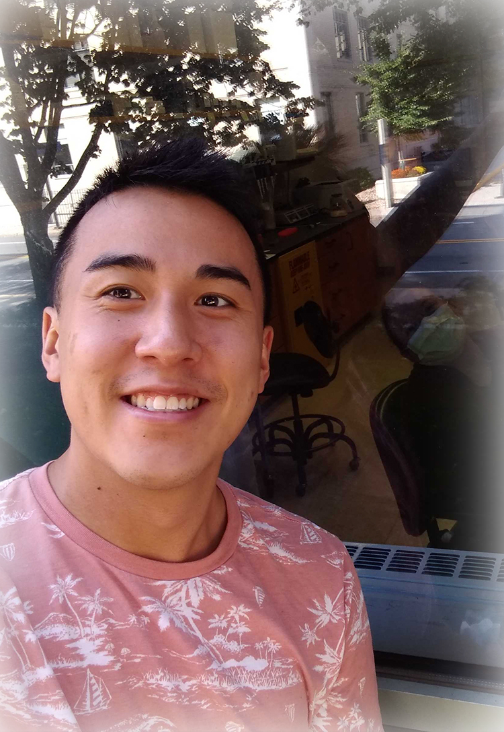

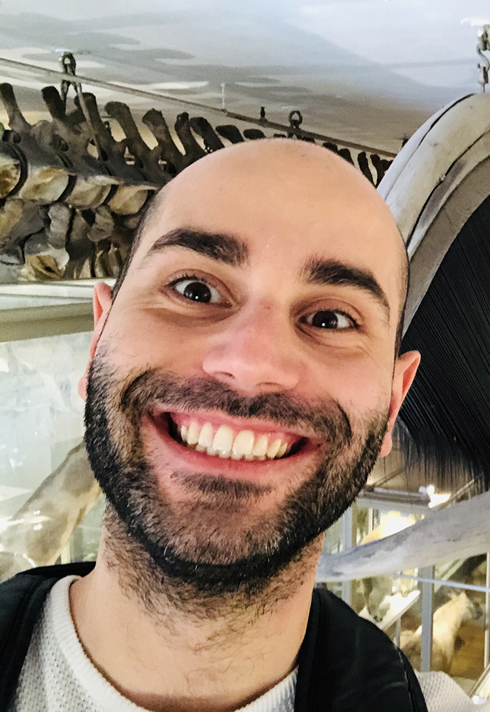


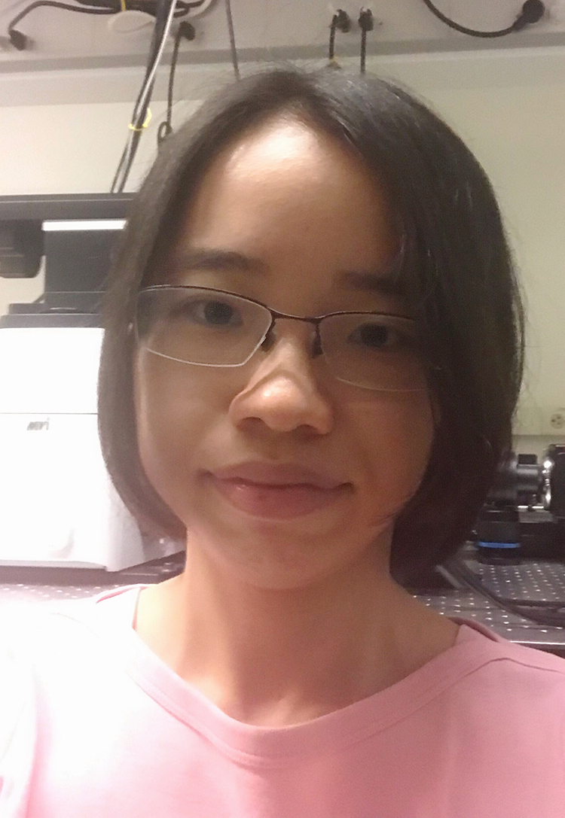






Acknowledgements
Advice and materials: Martin LaFleur
Arlene Sharpe
Karthik Hullahalli
Matt Waldor

Slide 14
Thank you
The End

